Slide 1
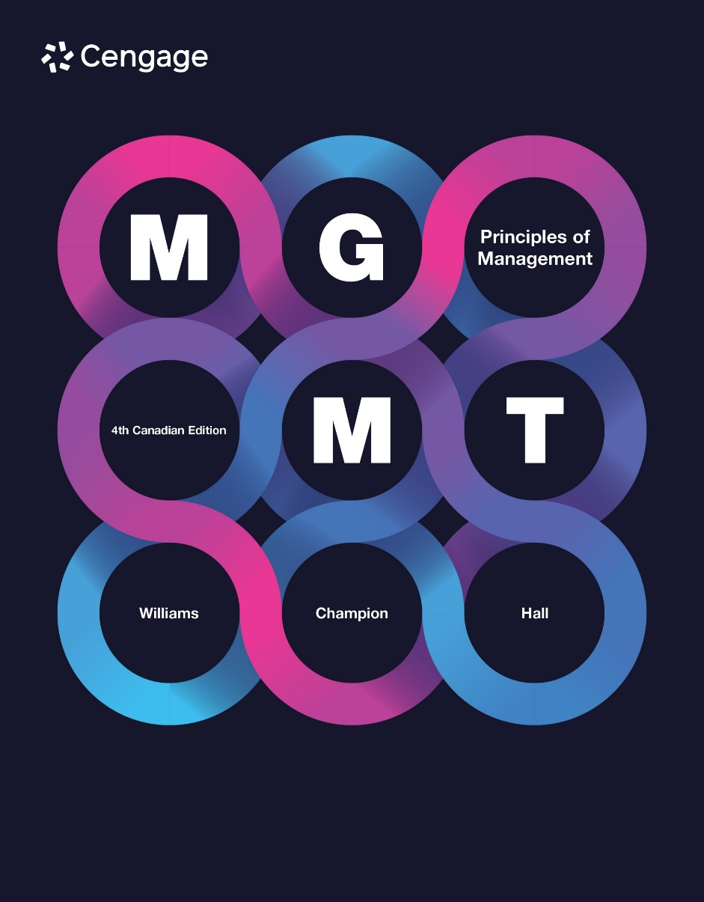

Slide 2
Chapter 12 - BUSA 7250
Motivation
23 Jan 2025
Lecture 3
Dr Ike Hall

Slide 3
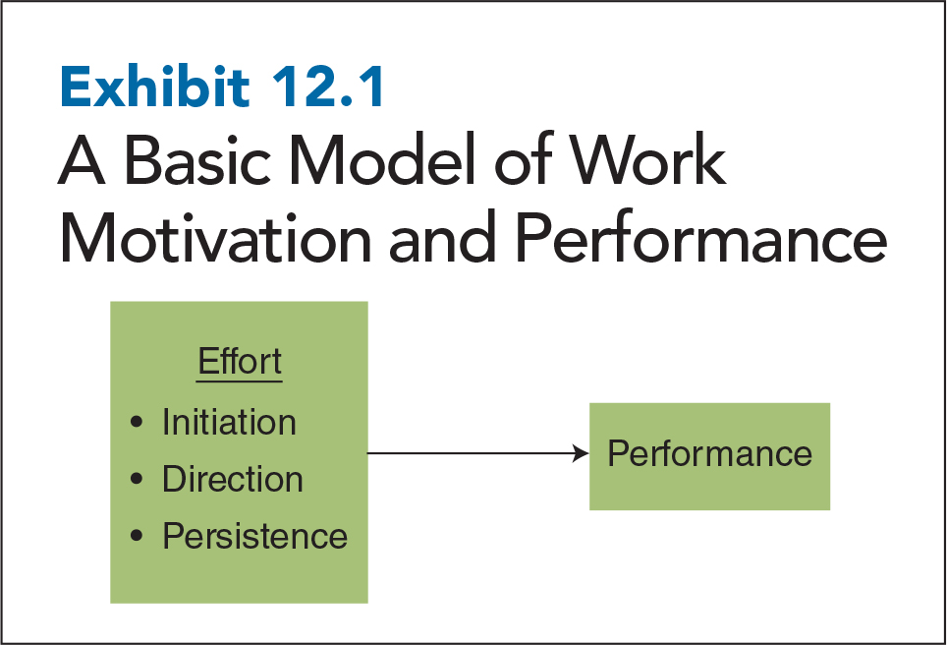
12-3
Notes:
Motivation: set of forces that initiates, directs, makes people persist in their efforts to accomplish a goal
Initiation of effort: concerned with the choices people make about how much effort to put into their jobs
Direction of effort: concerned with the choices people make deciding where to put effort into their jobs
Persistence of effort: concerned with the choices people make about how long they will put the effort into their jobs before reducing or eliminating those efforts
When people think of work motivation, they think that working hard (effort) should lead to doing a good job (performance). The exhibit shows a basic model of work motivation and performance displaying this process.

Slide 4
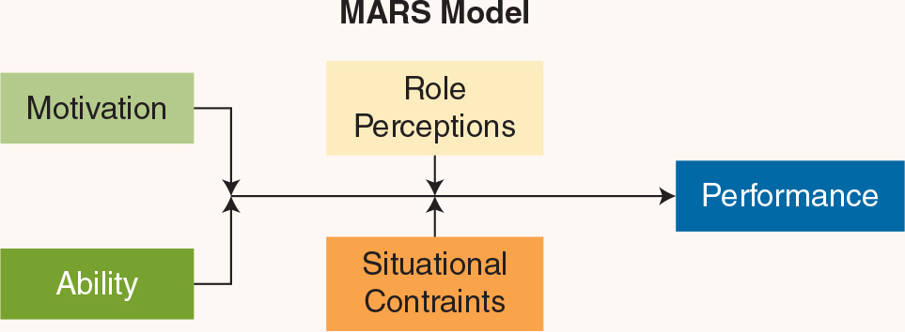
Effort and Performance
Notes:
Motivation is just one of four primary determinants of job performance. In industrial psychology, job performance is frequently represented by the MARS model.
In this formula, job performance is how well someone performs the requirements of the job. Motivation, as defined above, is effort, the degree to which someone works hard to do the job well. Ability is the degree to which workers possess the knowledge, skills, and talent they need to do a job well. Role perceptions involves people understanding the specific tasks assigned to them, the relative importance of those tasks, and the preferred behaviours to accomplish those tasks. And situational constraints are factors beyond the control of individual employees such as tools, policies, and resources that have an effect on job performance.

Slide 5
The Multiplicative Function of Motivation
Motivation
Ability
Situational
Constraints
Job
Performance
Effort put forth on the job
Capacity to do the job
External factors affecting performance
12-5
Notes:
Since job performance is a multiplicative function of motivation times ability times situational constraints, job performance will suffer if any one of these components is weak. Does this mean that motivation doesn’t matter? Not at all. It just means that all the motivation in the world won’t translate into high performance when you have little ability and high situational constraints.

Slide 6
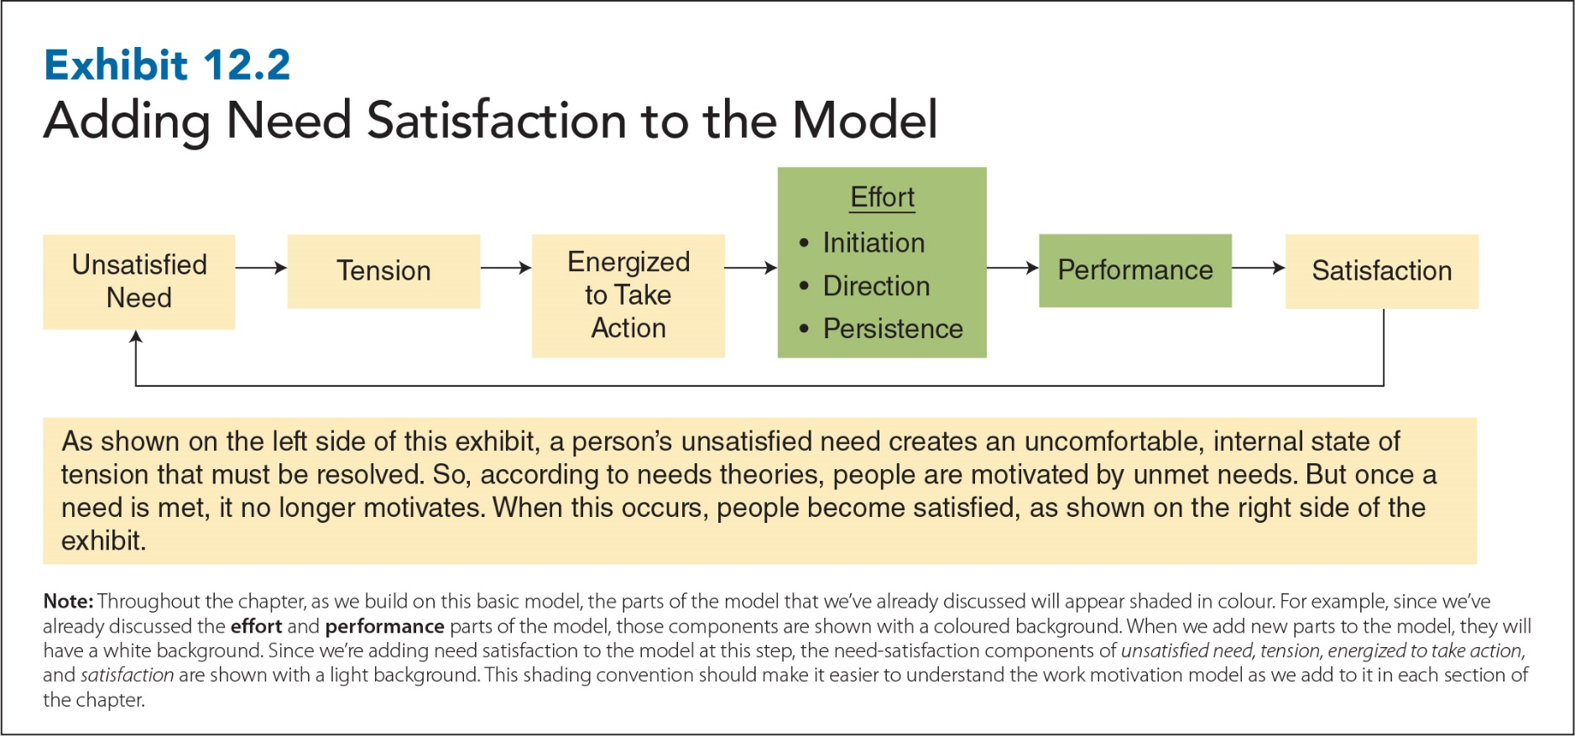
Adding Need Satisfaction to the Model
12-6
Notes:
Needs: the physical or psychological requirements that must be met to ensure survival and well-being

Slide 7
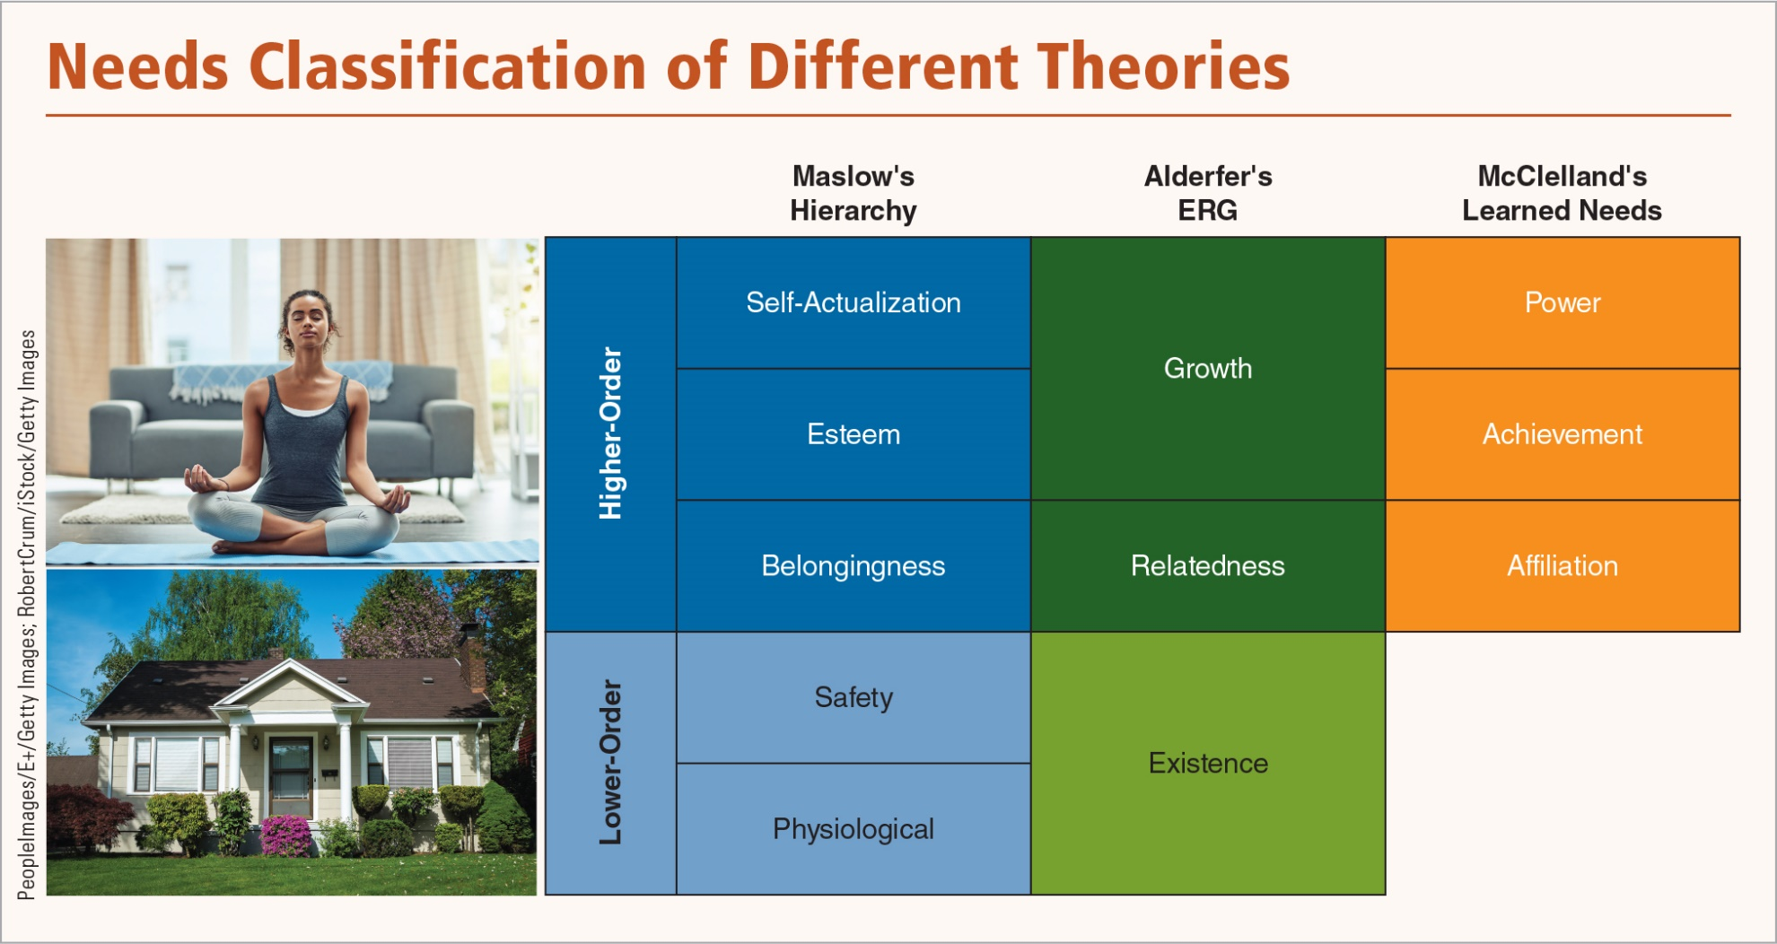
Needs Classification of Different Theories
Notes:
Consider three well-known needs theories:
Maslow’s Hierarchy of Needs: suggests that people are motivated by physiological (food/water), safety (physical/economic), belongingness (friendship, love, social interaction), esteem (achievement and recognition), and self-actualization (realizing full potential) needs. According to Maslow, needs are arranged in a hierarchy from low (physiological) to high (self-actualization), and people are motivated by their lowest unsatisfied need. As each need is met, they work their way up the hierarchy from physiological toward self-actualization needs.
2. Alderfer’s ERG Theory: collapses Maslow’s five needs into three--existence (safety and physiological needs), relatedness (belongingness), and growth (esteem and self-actualization). Alderfer says that people can be motivated by more than one need at a time. Furthermore, he suggests that people are just as likely to move down the needs hierarchy as up, particularly when they are unable to achieve satisfaction at the next higher need level.
3. McClelland’s Learned Needs Theory: suggests that people are motivated by the need for affiliation (to be liked and accepted), the need for achievement (to accomplish challenging goals), or the need for power (to influence others).
Studies generally show that there is a logical progression and that higher-order needs will not motivate people as long as lower order needs remain unsatisfied.

Slide 8
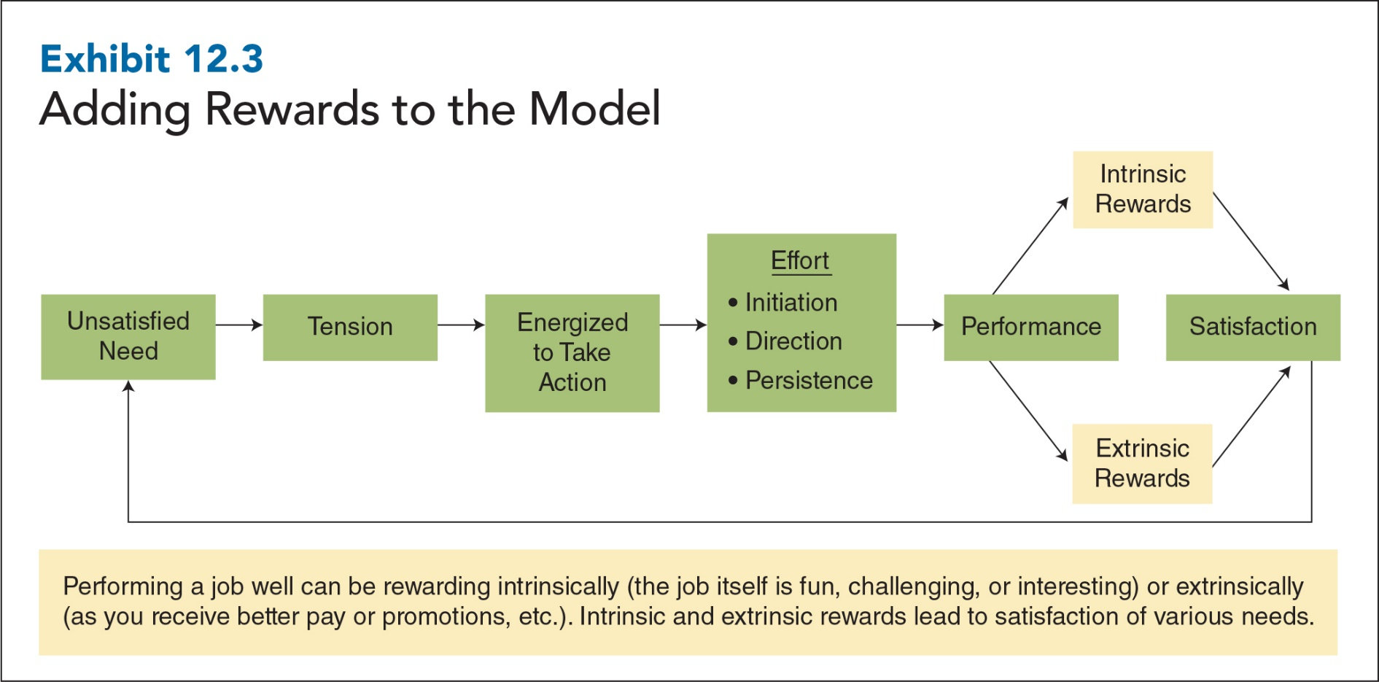
Adding Rewards to the Model
12-8
Notes:
Adding two more rewards to the model: extrinsic and intrinsic.

Slide 9
Extrinsic and Intrinsic Rewards
Extrinsic reward:
A reward that is tangible, visible to others, and given to employees contingent on the performance of specific tasks or behaviours
Intrinsic reward:
A natural reward associated with performing a task or activity for its own sake
12-9
Notes:
External agents (e.g., managers) determine and control the distribution, frequency, and amount of extrinsic rewards such as pay, company stock, benefits, and promotions. Companies use extrinsic rewards to motivate people to perform four basic behaviours: join the organization, regularly attend their jobs, perform their jobs well, and stay with the organization.
Examples of intrinsic rewards:
- A sense of accomplishment or achievement
- A feeling of responsibility
- The chance to learn something new or interact with others
- The fun that comes from performing an interesting, challenging, and engaging task
A number of surveys suggest that extrinsic and intrinsic rewards are both important. One survey found that the most important rewards were good benefits and health insurance, job security, a week or more of vacation (all extrinsic rewards), interesting work, the opportunity to learn new skills, and independent work situations (all intrinsic rewards). Also, employee preferences for intrinsic and extrinsic rewards appear to be relatively stable. Studies conducted over the past three decades have consistently found that employees are twice as likely to indicate that important and meaningful work matters more to them than what they are paid.

Slide 10
Motivating with the Basics
Steps in Motivating Employees:
1. Try to find out what employees needs are.
2. Satisfy lower order needs first.
3. Expect people’s needs to change.
Create opportunities for employees to satisfy higher-order needs.
12-10
Notes:
Start asking people what their needs are. If managers don’t know what the workers’ needs are, they won’t be able to provide them with opportunities and rewards that satisfy those needs.
Satisfy lower-order needs first. Higher-order needs won’t motivate people as long as lower-order needs stay unsatisfied. In practice, this means providing equipment, training, and knowledge to create a safe workplace free of physical risks, as well as paying employees enough to provide financial security.
Managers should expect people’s needs to change. Situations change, so what motivated people before may not motivate them now. What motivates people to accept a job (pay/benefits) may not motivate them once they actually have the job (job itself, opportunities for advancement). Managers should expect needs to change as people mature.
As needs change and lower-order needs are satisfied, create opportunities for employees to satisfy higher-order needs. One way for managers to meet employees’ higher-order needs is to create opportunities for employees to experience intrinsic rewards by providing challenging work, encouraging employees to take greater responsibility for work, and giving employees freedom to pursue tasks or projects that they find naturally interesting.

Slide 11
How Perceptions and Expectations Affect Motivation
Equity theory:
A theory that states people will be motivated at work when they perceive that they are being treated fairly
Notes:
In particular, equity theory stresses the importance of perceptions. So, whatever the actual level of rewards people receive, they must also perceive that they are being treated fairly relative to others.
So, whatever the actual level of rewards people receive, they must also perceive that they are being treated fairly relative to others. For example, the CEOs of the world’s largest firms now make about 280 times their average employee salary. By contrast, in 2020, CEOs of companies with less than $1 billion a year in revenues averaged about 4 times what the average worker makes. Many people believe that CEO pay is obscenely high and unfair. Others believe that CEO pay is fair because the supply and demand for executive talent largely determine what CEOs are paid.
Equity theory doesn’t focus on objective equity (that is, that CEOs make 280 times, or 4 times, more than average workers). Instead, equity theory says that equity, like beauty, is in the eye of the beholder (it is subjective).

Slide 12

Components of Equity Theory
Under-reward
Over-reward
Referent’s
Outcome/Input
Ratio
My
Outcome/Input
Ratio
12-12
Notes:
Outcome/input (O/I) ratio: the employee’s perception of how the rewards received from the organization compare with the employee’s contributions to the organization
Inputs: the contributions that employees make to the organization
Outcomes: the rewards that employees receive for their contributions to the organization
Referents: others with whom people compare themselves to determine if they have been treated fairly
After an internal comparison in which they compare their own outcomes to their own inputs, employees make an external comparison—that is, they compare their O/I ratio with the O/I ratio of a referent. When people perceive that their O/I ratio is equal to the referent’s O/I ratio, they conclude that they are being treated fairly; when people perceive that their O/I ratio is different from their referent’s O/I ratio, they conclude that they are being treated inequitably or unfairly.
Under-reward: a form of inequity in which you are getting fewer outcomes relative to inputs than your referent is getting
Over-reward: a form of inequity in which you are getting more outcomes relative to inputs than your referent

Slide 13
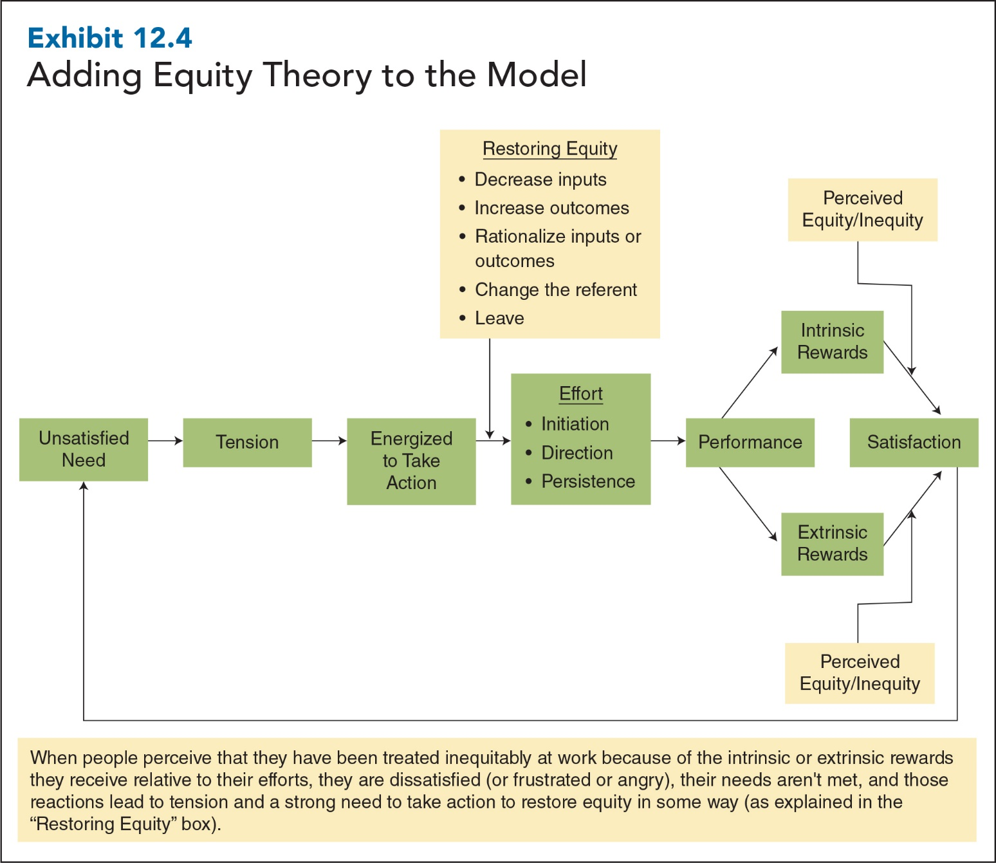
12-13
Notes:
The exhibit shows how perceived inequity affects satisfaction.
In the case of under-reward, this usually translates into frustration or anger; with over-reward, the reaction is guilt. These reactions lead to tension and a strong need to take action to restore equity in some way. At first, a slight inequity may not be strong enough to motivate an employee to take immediate action. But if the inequity persists or there are multiple inequities, tension may build over time until a point of intolerance is reached, and the person is energized to take action.
People who perceive that they have been under-rewarded may try to restore equity by decreasing or withholding their inputs (i.e., effort), increasing outcomes, rationalizing or distorting inputs or outcomes, changing the referent, or leaving the organization.

Slide 14
Motivating with Equity Theory
Steps in Motivating Employees:
Start by looking for and correcting major inequities.
Reduce employees’ inequities as much as possible.
Make sure the decision-making processes are fair (distributive and procedural).
12-14
Notes:
Equity theory makes us aware that an employee’s sense of fairness is based on subjective perceptions. What an employee considers grossly unfair may not affect another employee’s perceptions of equity. Different perceptions make it difficult for managers to create conditions that satisfy all employees, so it’s critical that they do their best to take care of major inequities that energize employees to take disruptive, costly, or harmful action, such as decreasing inputs or leaving.
Increasing outcomes is often the first and only strategy that companies use to restore equity, yet reducing employee inputs is just as viable a strategy. With dual-career couples working 50-hour weeks, more employees are looking for ways to reduce stress and restore the balance between work and family. It may make sense to ask employees to do less, not more; have them identify and eliminate 20 percent of the job that doesn’t increase productivity or add value for customers; and eliminate company-imposed requirements that really aren’t critical to the performance of managers, employees, or the company itself (e.g., unnecessary meetings and reports).
3. If employees perceive that the outcomes are unfair (i.e., distributive injustice) but that the decisions and procedures leading to those outcomes are fair (i.e., procedural justice), they are much more likely to seek constructive ways of restoring equity, such as discussing these matters with their managers. If employees perceive both distributive and procedural injustice, they may resort to more destructive tactics, such as withholding effort, absenteeism, tardiness, sabotage, and theft.

Slide 15
Fair Decision-Making Processes
Distributive justice:
The perceived degree to which outcomes and rewards are fairly distributed or allocated
Procedural justice:
The perceived fairness of the process used to make reward allocation decisions
12-15
Notes:
Procedural justice matters because even when employees are unhappy with their outcomes (i.e., low pay), they’re much less likely to be unhappy with company management if they believe that the procedures used to allocate outcomes were fair. For example, employees who are laid off tend to be hostile toward their employer when they perceive that the procedures leading to the layoffs were unfair.
By contrast, employees who perceive layoff procedures as fair tend to continue to support and trust their employer.

Slide 16
Expectancy Theory
Expectancy theory: a theory that states that people will be motivated to the extent to which they believe that their efforts will lead to good performance, that good performance will be rewarded, and that they will be offered attractive rewards

Slide 17
Expectancy Theory: Components
Valence: Attractiveness or desirability of various rewards or outcomes
Expectancy: Perceived relationship between effort and performance
Instrumentality: Perceived relationship between performance and rewards
Motivation = Valence x Instrumentality x Expectancy
Notes:
Valence: the attractiveness or desirability of various rewards and outcomes
Expectancy theory recognizes that the same reward or outcome, such as a promotion, will be highly attractive to some people, will be highly disliked by others, and will not make much difference one way or another to still others. When people are deciding how much effort to put out, expectancy theory says that they will consider the valence of all possible rewards and outcomes that they can receive from their jobs. The greater the sum of those valences (each of which could be positive, negative, or neutral), the more effort people will choose to put forth on the job.
Expectancy: the perceived relationship between effort and performance. When expectancies are strong, employees believe that their hard work and efforts will result in good performance, so they work harder. When expectancies are weak, employees figure that no matter what they do or how hard they work, they won't be able to perform their jobs successfully, so they don't work as hard.
Instrumentality: the perceived relationship between performance and rewards. When instrumentality is strong, employees believe that improved performance will lead to better and more rewards, so they choose to work harder. When instrumentality is weak, employees don’t believe that better performance will result in more or better rewards, so they choose not to work as hard.
Expectancy theory holds that for people to be highly motivated, all three variables—valence, expectancy, and instrumentality—must be high. Expectancy theory can be represented by the simple equation presented in the slide.

Slide 18
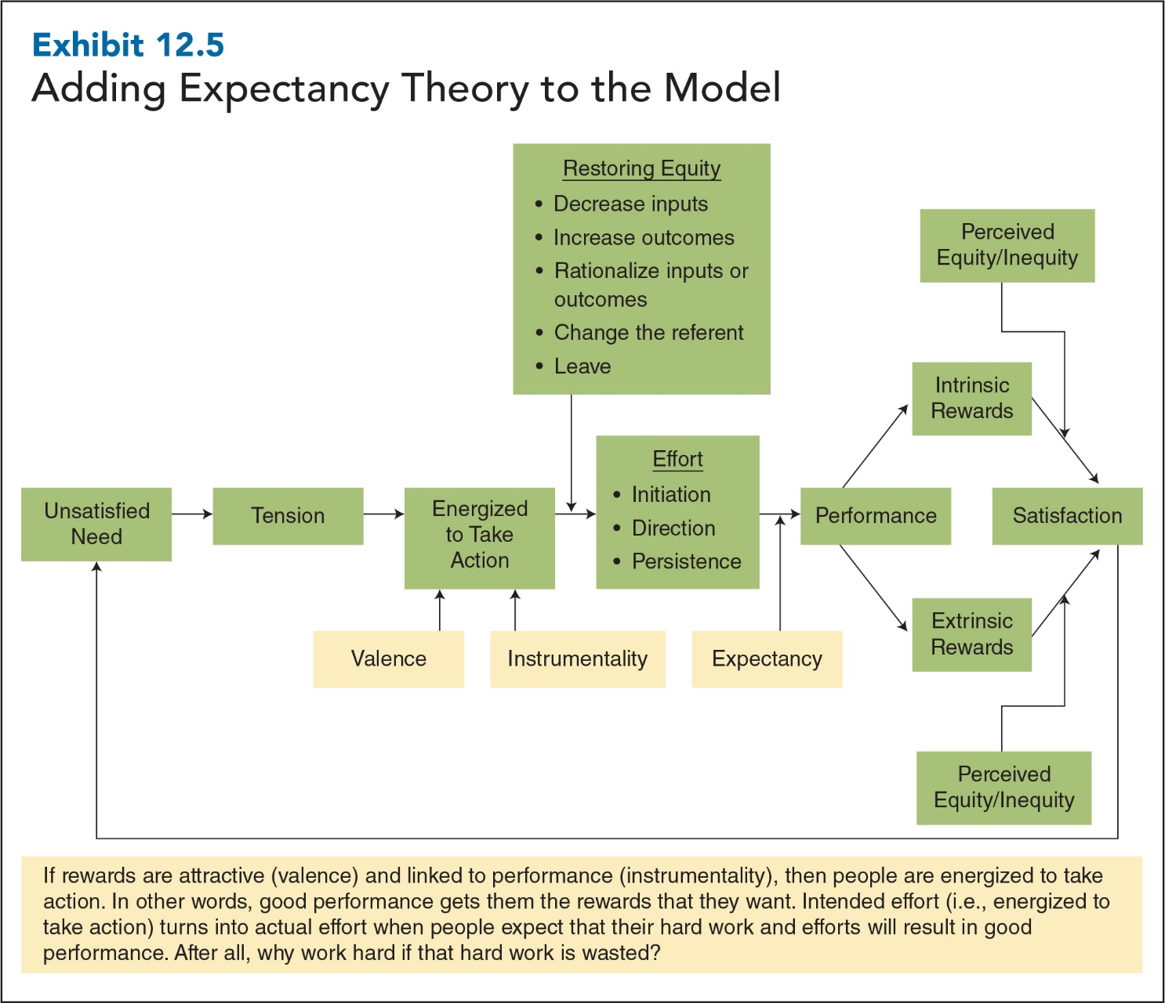
12-18
Notes:
Exhibit 12.5 incorporates expectancy theory variables into the motivation model.

Slide 19
Motivating with Expectancy Theory
Steps in Motivating Employees:
Try your best to discover what employees want from their jobs.
Link rewards to individual performance in a clear and understandable way.
Empower employees to make decisions.
12-19
Notes:
Managers can take practical steps to use expectancy theory to motivate employees. First, they can systematically gather information to find out what employees want from their jobs.
Second, managers can take specific steps to link rewards to individual performance in a way that is clear and understandable to employees. Unfortunately, most employees are extremely dissatisfied with the link between pay and performance in their organizations.
Finally, managers should empower employees to make decisions. When valent rewards are linked to good performance, people should be energized to take action. But this works only if they also believe that their efforts will lead to good performance.

Slide 20
Reinforcement Theory
Reinforcement:
The process of changing behaviour by changing the consequences that follow behaviour
Reinforcement theory:
A theory that states that behaviour is a function of its consequences, that behaviours followed by positive consequences will occur more frequently, and that behaviours followed by negative consequences, or not followed by positive consequences, will occur less frequently
12-20

Slide 21
Components of Reinforcement Theory
Reinforcement contingencies:
The cause-and-effect relationships between the performance of specific behaviours and specific consequences
Schedule of reinforcement:
The set of rules regarding reinforcement contingencies, such as which behaviours will be reinforced, which consequences will follow those behaviours, and the schedule by which those consequences will be delivered
12-21
Notes:
Reinforcement contingencies are the cause-and-effect relationships between the performance of specific behaviours and specific consequences. For example, if you get docked an hour’s pay for being late to work, then a reinforcement contingency exists between a behaviour (being late to work) and a consequence (losing an hour’s pay)

Slide 22
Components of Reinforcement Theory
The cause-and-effect relationships between the performance of specific behaviours and specific consequences
Reinforcement
Contingencies
Positive
Reinforcement
Negative
Reinforcement
Extinction
Punishment
Strengthens behaviour by withholding an unpleasant consequence when employees perform a specific behaviour
Weakens behaviour (i.e., decreases its frequency) by following behaviours with undesirable consequences
A positive consequence is no longer allowed to follow a previously reinforced behaviour
Schedule of
Reinforcement
Continuous
Intermittent
Follows every instance of a behaviour
Delivered after a specified or average time has elapsed or after a specified or average number of behaviours has occurred

Slide 23
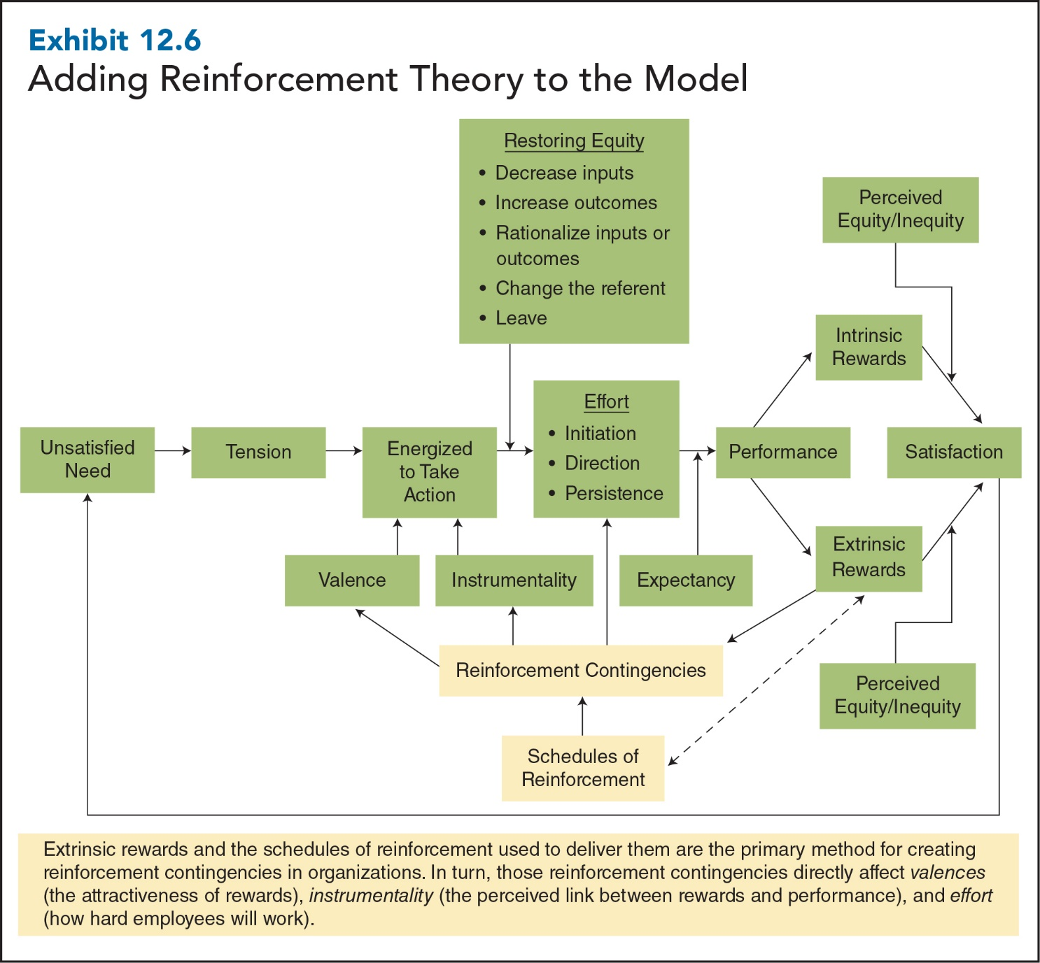
12-23
Notes:
The exhibit incorporates reinforcement contingencies and reinforcement schedules into our motivation model. First, notice that extrinsic rewards and the schedules of reinforcement used to deliver them are the primary method for creating reinforcement contingencies in organizations. In turn, those reinforcement contingencies directly affect valences (the attractiveness of rewards), instrumentality (the perceived link between rewards and performance), and effort (how hard employees will work).

Slide 24
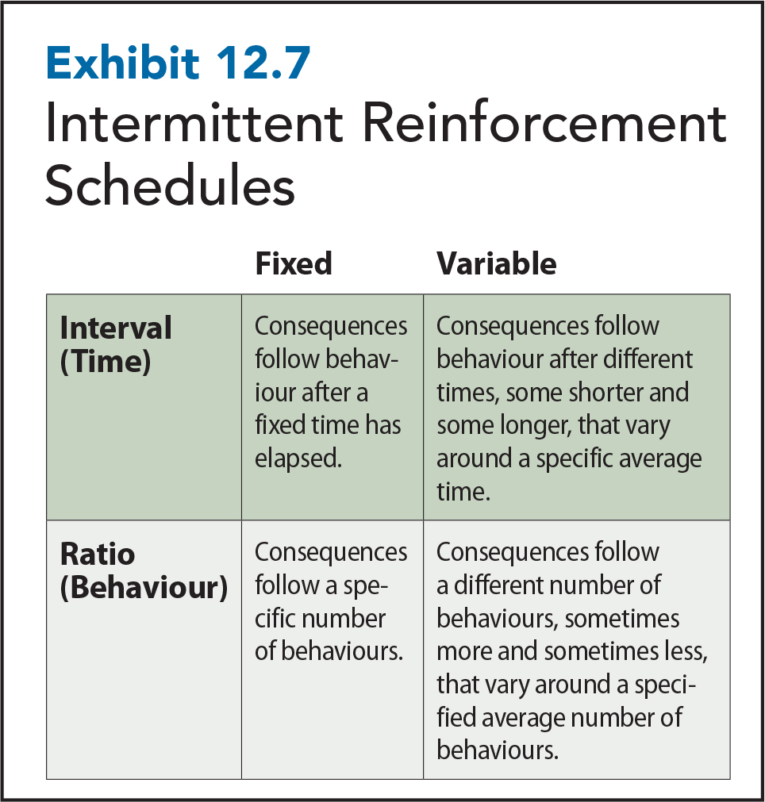
12-24
Notes:
Examples:
Fixed interval reinforcement schedules. Most people receive their paycheques on a fixed interval schedule (e.g., once or twice per month). As long as they work (behaviour) during a specified pay period (interval), they get a paycheque (consequence).
Variable interval reinforcement schedules. On a 90-day variable interval reinforcement schedule, you might receive a bonus after 80 days or perhaps after 100 days, but the average interval between performing your job well (behaviour) and receiving your bonus (consequence) will be 90 days.
Fixed ratio reinforcement schedules. A car salesperson might receive a $1,000 bonus after every 10 sales. Therefore, a salesperson with only 9 sales would not receive the bonus until he or she finally sold a 10th car.
Variable ratio reinforcement schedules. With a 10-car variable ratio reinforcement schedule, a salesperson might receive the bonus after 7 car sales or after 12, 11, or 9 sales, but the average number of cars sold before receiving the bonus would be 10 cars.

Slide 25
Motivating with Reinforcement Theory
Steps in motivating employees:
Identify critical, observable, performance-related behaviours.
Measure baseline frequencies of these behaviours.
Analyze the causes and consequences of these behaviours.
Intervene by using positive and negative reinforcement to increase the frequency of these behaviours.
Evaluate the extent to which the intervention actually changed workers’ behaviour by comparing behaviour after the intervention to the original baseline of behaviour before the intervention.
12-25
Notes:
In addition to these five steps, managers should remember three other key things when motivating with reinforcement theory:
Don’t reinforce the wrong behaviours.
Correctly administer punishment at the appropriate time.
Choose the simplest and most effective schedule of reinforcement.

Slide 26
Goal-Setting Theory
Goal: A target, objective, or result that someone tries to accomplish
Goal-setting theory: A theory that states that people will be motivated to the extent to which they accept specific, challenging goals and receive feedback that indicates their progress toward goal achievement

Slide 27
Components of Goal-Setting Theory
Goal Specificity
Goal Difficulty
Performance Feedback
Goal Acceptance
Notes:
Goal specificity: extent to which goals are detailed, exact, and unambiguous
Goal difficulty: extent to which a goal is hard or challenging to accomplish
Goal acceptance: extent to which people consciously understand and agree to goals
Performance feedback: information about the quality or quantity of past performance that indicates whether progress is being made toward the accomplishment of a goal

Slide 28
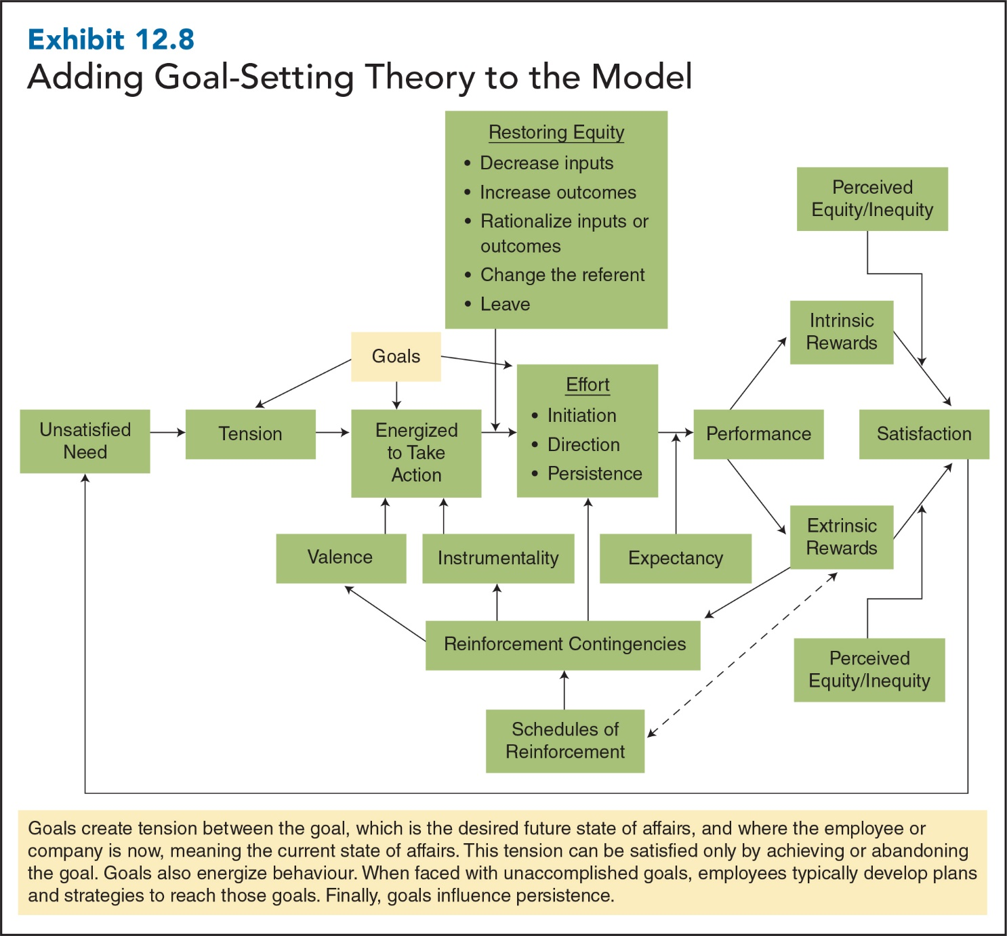
12-28
Notes:
The exhibit incorporates goals into the motivation model by showing how they directly affect the tension, effort, and the extent to which employees are energized to take action.

Slide 29
Motivating with Goal-Setting Theory
Steps in motivating employees:
Assign specific, challenging goals.
Make sure that workers truly accept organizational and personal goals.
Provide frequent, specific, performance-related feedback.
12-29
Notes:
Feedback leads to stronger motivation and effort in three ways:
First: Receiving specific feedback that indicates how well they’re performing can encourage employees who don’t have specific, challenging goals to set goals to improve their performance.
Second: Once people meet goals, performance feedback often encourages them to set higher, more difficult goals.
Third: Feedback lets people know whether they need to increase their efforts or change strategies in order to accomplish their goals.
So, to motivate employees with goal-setting theory, make sure they receive frequent performance-related feedback so that they can track their progress toward goal completion. Simple feedback benefits from immediacy and spontaneity. If you want to recognize an employee for going the extra mile, you need to do it immediately. Furthermore, you need to articulate to employees what it was about their performance that you most appreciated.

